Slide 1


Chocolate Sales Data Analysis and Visualization
Presented by
Emal Zazai

Slide 2
Problem Statement
Predict future sales trends based on historical data.
Which Chocolate brand is most sold.
Which country is consuming chocolate the most.
Analyze which chocolate categories perform best in various locations.
Chocolate sales total revenue.
Analyze which chocolate categories perform best in various locations.
Optimize inventory, pricing, and marketing strategies based on data insights.

Slide 3
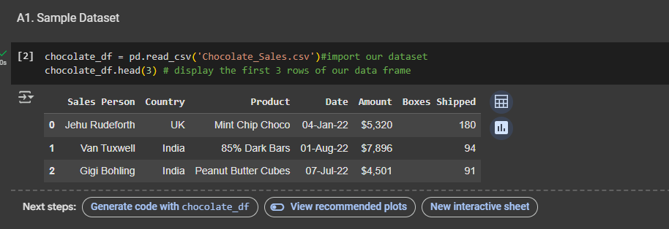
Data Collection
This dataset contains detailed records of chocolate sales, including product details, sales quantities, revenue, and customer segments. It is designed for sales forecasting, trend analysis, and business intelligence, helping businesses optimize pricing strategies, inventory management, and customer targeting.
The dataset is downloaded from Kaggle website. Here is the link for the dataset. https://www.kaggle.com/datasets/atharvasoundankar/chocolate-sales/data

Slide 4
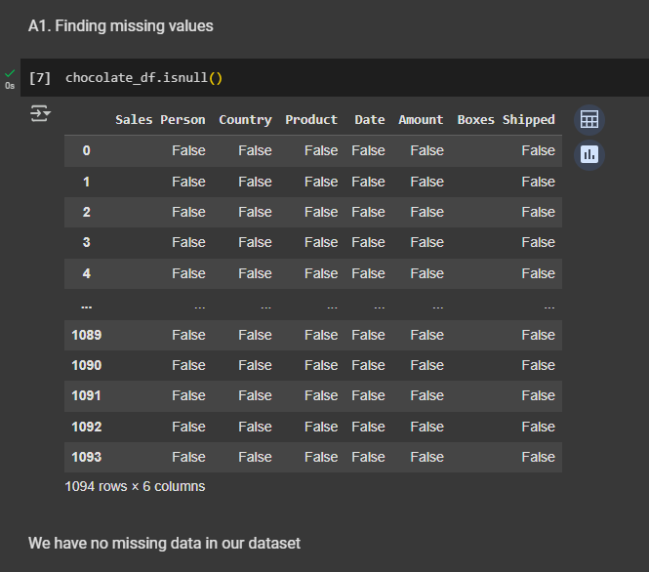
Data cleaning
Data cleaning is the process of identifying and correcting errors, inconsistencies, or irrelevant data within a dataset.
We have no missing values in our dataset

Slide 5
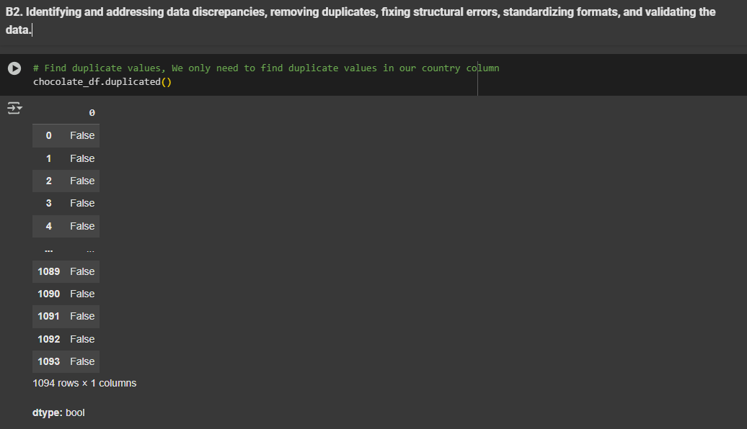
Next step
Identifying and addressing data discrepancies, removing duplicates, fixing structural errors, standardizing formats, and validating the data

Slide 6
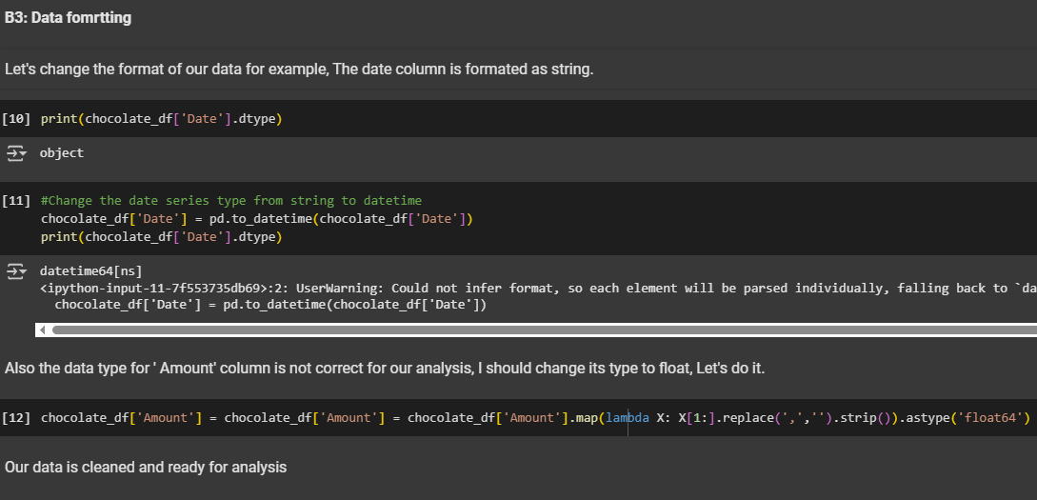
B3: Data formatting

Slide 7
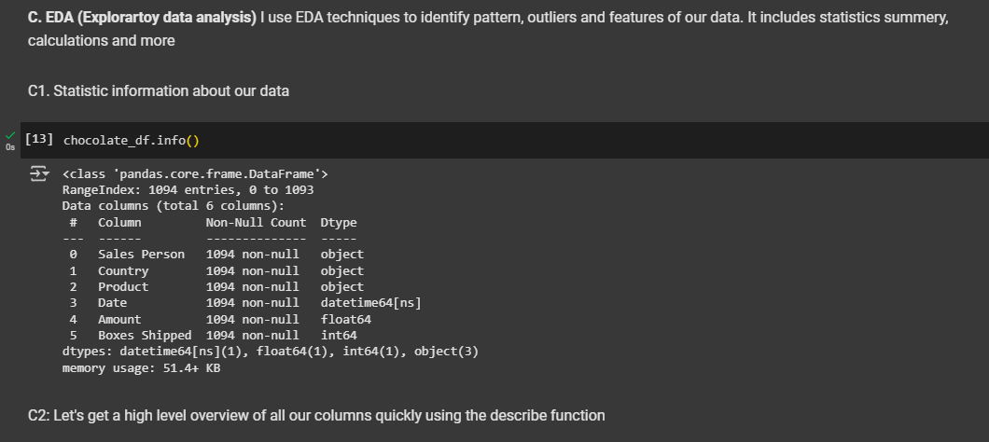
EDA (Exploratory Data Analysis)

Slide 8
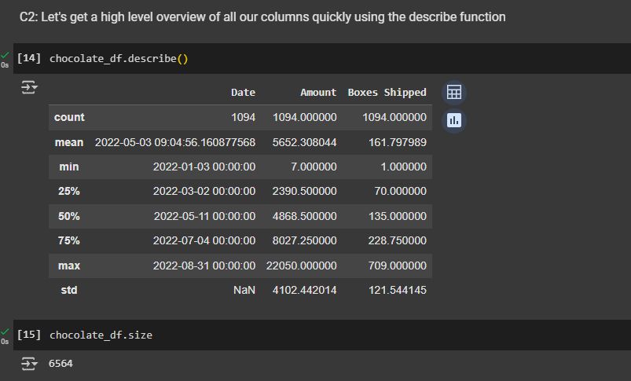
EDA (Exploratory Data Analysis)

Slide 9
EDA (Exploratory Data Analysis)

Slide 10
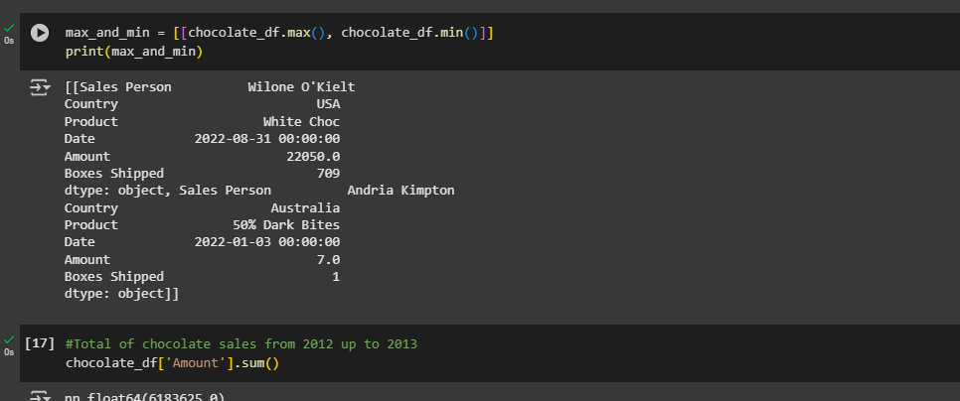
EDA (Exploratory Data Analysis)

Slide 11

03
Data visualization
Graphical representation of our data

Slide 12
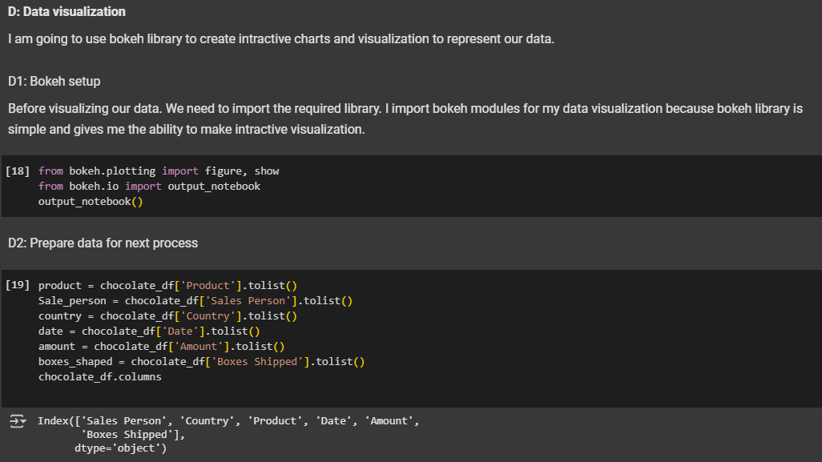

Slide 15
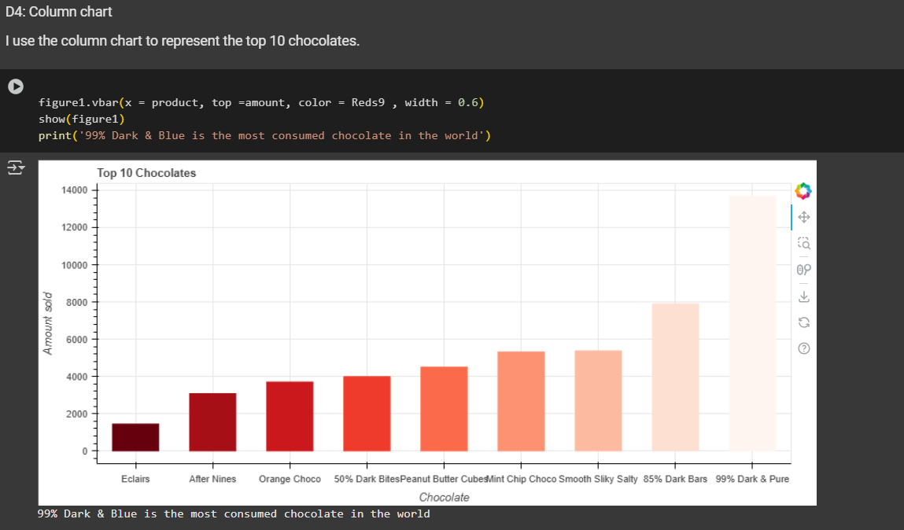

Slide 16
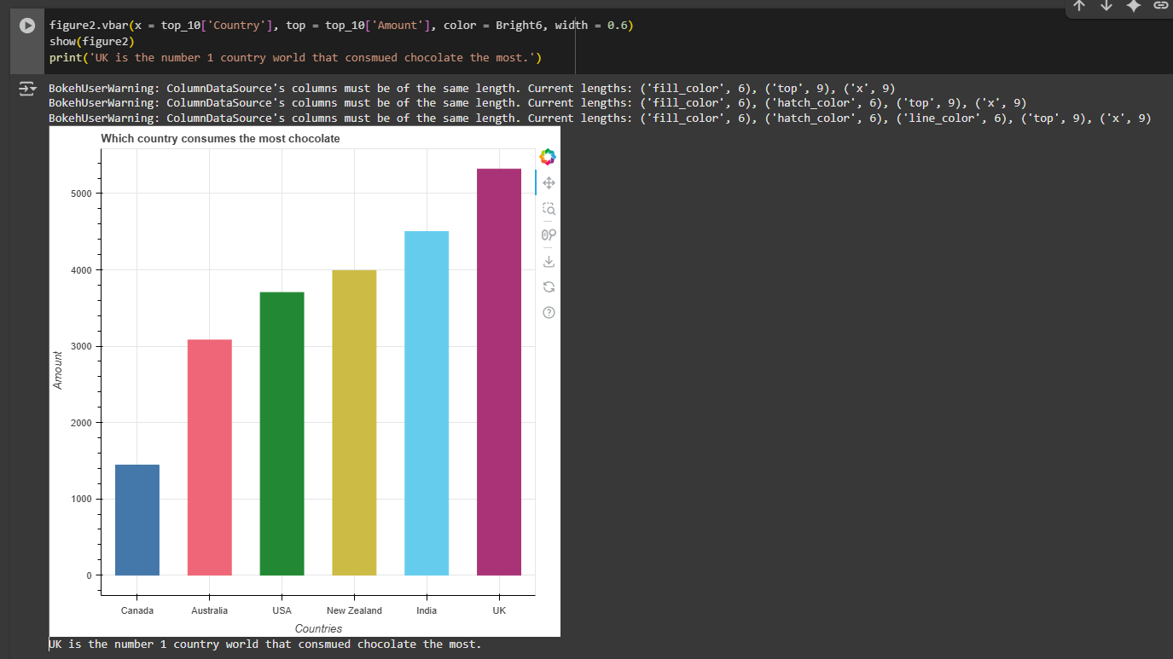

Slide 17
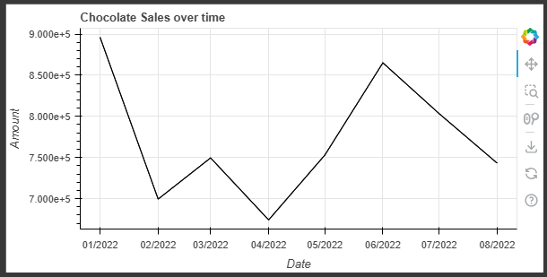
Chocolate sales over time

Slide 18
Finding
Chocolate sales - Date
Top Chocolate consumer
99% Dark & Blue chocolate
Chocolate sales peak during the month of January because of Christmas and New year.
Globally, 99% Dark & Blue chocolate records the highest sales in its category.
The United Kingdom has the highest chocolate consumption globally.
Chocolate sales total revenue
Total revenue for the chocolate is sale for one year is than 11 million dollar

Slide 19
Thank you

